Slide 1
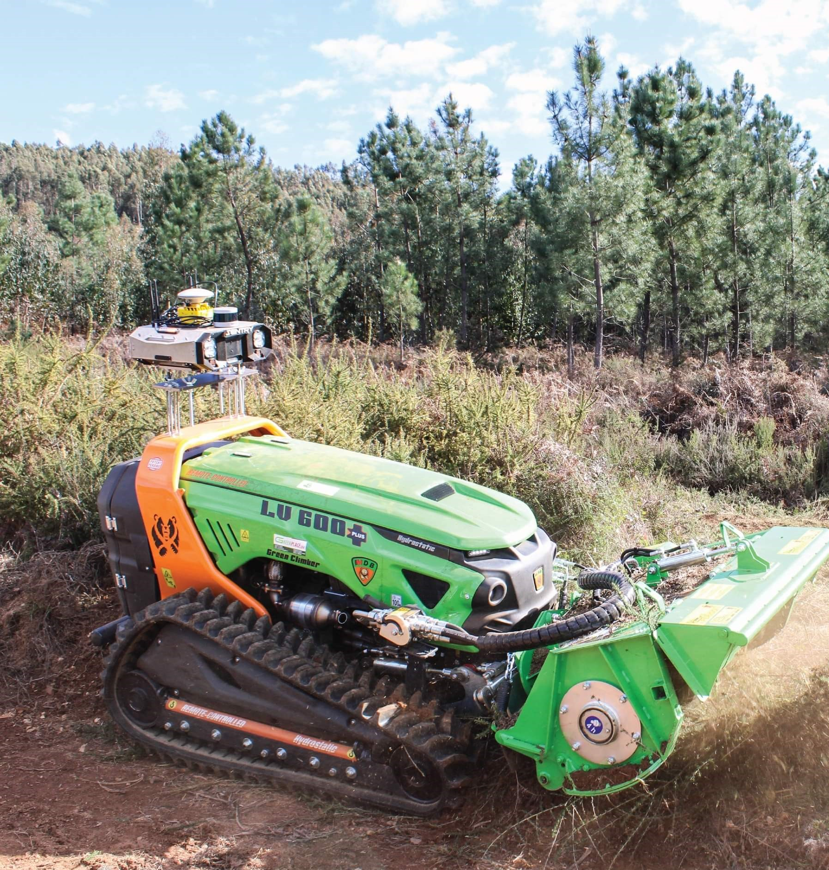




CONFERENCE/VENUE/DATE
MAIN TITLE
ADD YOUR IMAGE
AND SEND IT TO BACK
Author1, Author2…
Affiliation
Institutional Logos
FCT Project Ref. 2023.16314.ICDT
Supported by national funds through FCT – Fundação para a Ciência e a Tecnologia, I.P., under project RUGGED – “Robust Uncrewed Ground technoloGy dEvelopment and Deployment”

Slide 2




STRATEGIC PILLARS
CORE TECHNOLOGICAL CAPABILITIES
UGV TRACKED MOBILITY
SENSORS & EDGE AI
FIELD OPERATIONS
Robust all-terrain mobility for dense vegetation & steep slopes.
Multi-spectral LiDAR perception and edge decision analytics.
Direct deployment from research lab to active wildfire zones.
RUGGED Brand Architecture & Technical Capabilities
Section 01 / Overview

Slide 3
SYSTEM ARCHITECTURE
SECTION 01
SYSTEM ARCHITECTURE & AUTONOMOUS WORKFLOW
End-to-end integration combining aerial satellite feeds, local ground robotics, digital twins, and tactical field teams.
RUGGED Technical Documentation
UGV & DATA INTEGRATION

Slide 4
SYSTEM WORKFLOW
INTEGRATED DECISION PIPELINE
FIELD OPERATIONS
ACTIONS & DECISIONS
DATA INPUT
AI & MODELS
RUGGED PLATFORM
Ground, aerial, and satellite imagery.
Wind, fire spread, and risk models.
UGVs, tactical teams, and assets.
Targeted wildfire prevention intervention.
Digital Twin & DSS Center
Real-time bi-directional telemetry loop
Autonomous System Workflow

Slide 5




HARDWARE & SENSORS
ROBOTIC PERCEPTION SUITE
GNSS & NAVIGATION
RADAR & PERCEPTION
Centimeter RTK precision under canopy.
Obstacle avoidance in dense smoke.
OPTICAL SENSORS
AI EDGE PROCESSING
High-resolution multispectral payload.
Onboard real-time hazard mapping.
Integrated payload sensor array
Robotic Perception

Slide 6

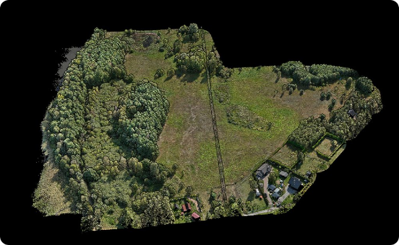
MULTI-MODAL DATA
MULTI-SCALE DATA FUSION
1
MULTISPECTRAL SATELLITE
Macroscopic vegetation stress and moisture index monitoring.
2
AERIAL RGB & THERMAL
Drone overwatch for localized active hotspot detection.
3
LIDAR ELEVATION MAPPING
3D digital elevation models for canopy fuel analysis.
Multi-scale remote sensing integration
Geospatial Intelligence

Slide 7
PERFORMANCE METRICS
OPERATIONAL BENCHMARKS
95%
<2cm
12h
100%
Water Savings
RTK Accuracy
Mission Autonomy
Real-Time Sync
Targeted precision dosing
Dense canopy positioning
Continuous field duty
Instant DSS telemetry updates
Validated under simulated wildland tests
System Performance

Slide 8
FIELD DEPLOYMENT
SECTION 02
FIELD OPERATIONS & WILDLAND PROTECTION
Deploying ground robotics directly into extreme terrain to establish active fire suppression barriers.
RUGGED Tactical Operations
ROBOTICS & WILDLANDS

Slide 9
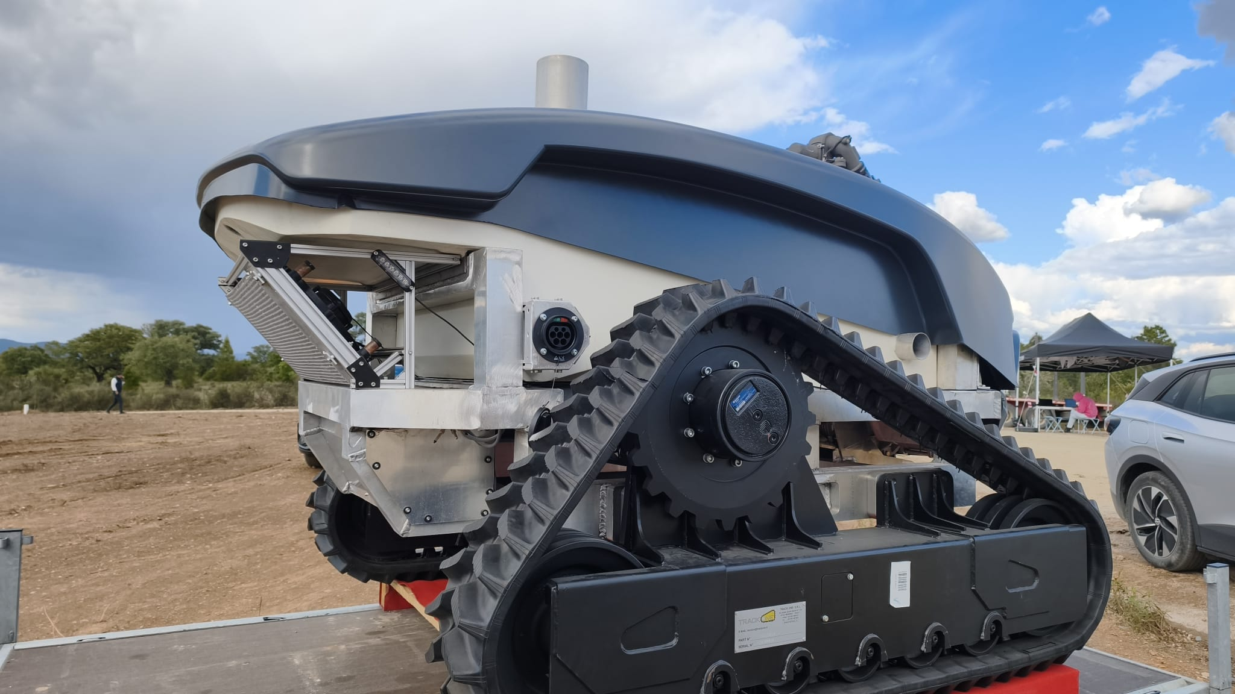
FIELD TRIALS
RUGGED UGV DEPLOYMENT
ALL-TERRAIN TRACKED CHASSIS
High clearance over fallen logs, rocks, and 45-degree inclines.
HYBRID POWER DRIVETRAIN
Extended endurance combining high-capacity batteries and silent propulsion.
TACTICAL TELEMETRY LINK
Resilient mesh network C2 communication under heavy foliage.
Real-world UGV testing in European pine forests
Operational Validation

Slide 10
IMPLEMENTATION
DEPLOYMENT ROADMAP
PHASE 01
PHASE 02
PHASE 03
PHASE 04
SENSOR SETUP
NAV TESTING
SWARM CONTROL
ACTIVE FIELD OPS
Calibrating LiDAR & thermal cameras on UGV payload.
Autonomous obstacle traversal in obstacle terrain.
Multi-agent coordination between aerial & ground units.
Full operational integration with local fire authorities.
2024–2026 Development Timeline
Project Milestones

Slide 11

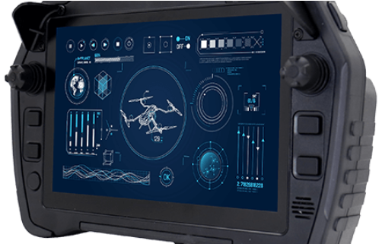
MISSION STATEMENT
"Robust technology for safer and more resilient forests and communities."
Eliminating human risk in severe environmental disasters through intelligent ground-first robotics.
RUGGED Project Core Impact
Community Resilience

Slide 12
VISUAL IDENTITY
REFERENCES
CHARCOAL
FOREST GREEN
SAFETY ORANGE
#20262B
#315C45
#F28C28
ELECTRIC CYAN
STONE GREY
OFF WHITE
#19A7B8
#7B8587
#F2F3F0
Typography
Montserrat — headings / titles / emphasis
Aptos — body / captions / tables
2024–2026 Development Timeline
Project Milestones

